Slide 1

FSMO Roles in Active Directory
Antonette Simms

Slide 2
What are FSMO Roles?
FSMO (Flexible single master operation)
FSMO roles are tasks that are in the active directory.
They are assigned to one or more domain controllers in a domain or forest.
These roles are very important for the functioning and management of an active directory environment.
There are 5 FSMO roles.

Slide 3
What are the 5 FSMO Roles?
01
02
02
03
04
Schema Master
RID Master
PDC Emulator
Domain Naming Master
Infrastructure Master

Slide 4
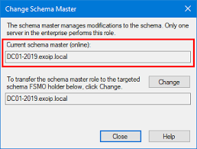
Schema Master
The schema master role is a forest wide role.
The schema is responsible for making changes to the schema in the active directory.
This role is controlled by only one domain controller in the entire forest and is very necessary, when making modifications to this schema, which includes adding or removing attributes or classes

Slide 5
Why is Schema Master Important?
The Schema Master is essential It enables organizations to customize their directory to meet their specific needs, ensure compatibility with existing applications, maintain data integrity and security, and adapt to changing requirements over time.

Slide 6
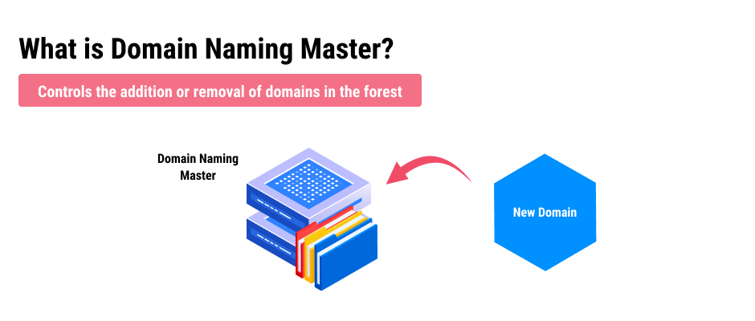
Domain Naming Master
The domain naming master is a forest wide role .
The domain naming master is is responsible for managing the addition, or the removal of domains in the forest.
The domain naming master also works to make sure that the user does not create another domain with the same name as the first domain.

Slide 7
Why is Domain Naming Master Important?
Domain Naming Master Its importance lies in its ability to supporting the organization's identity and access management requirement

Slide 8
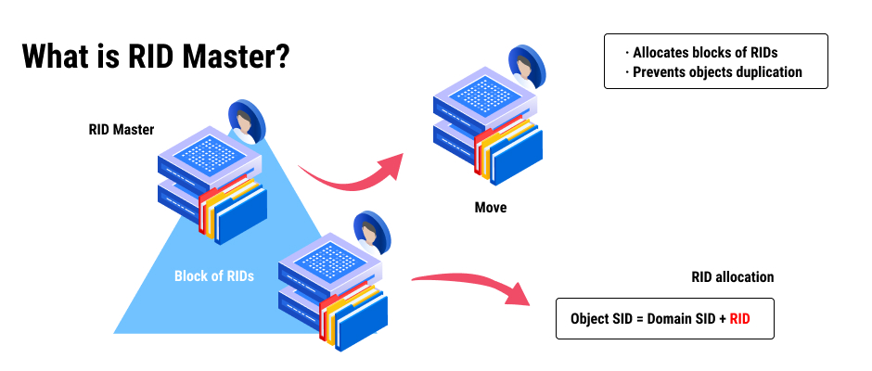
RID (Relative identifier) Master
RID is a domain wide role and each domain has one .
RID assigns blocks of SID ( security identifier ) values for each object created in active directory such as users groups and computers.
RID is also responsible for moving objects from one domain to another within a forest.

Slide 9
Why is RID Master Important?
RID Its role is critical in preventing SID collisions, supporting trust relationships, optimizing replication, and ensuring efficient resource access across domains.

Slide 10
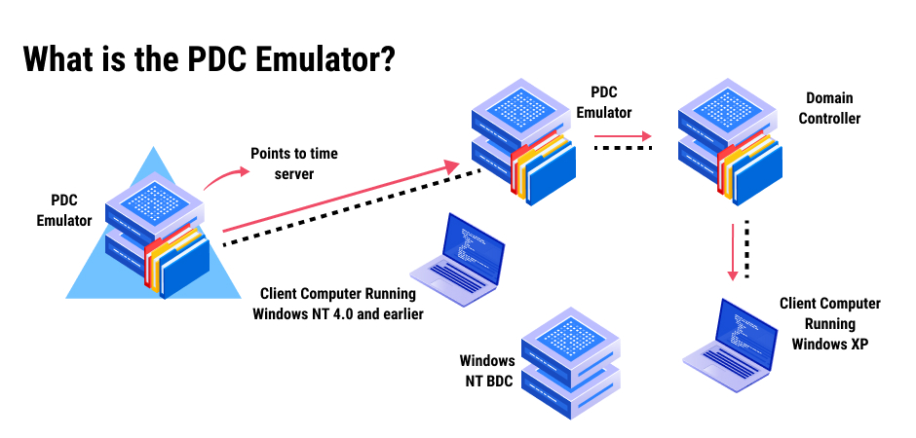
PDC (Primary Domain Controller) Emulator
PDC Emulator is a domain wide role.
PDC Emulator has many roles it is responsible for authenticated request, changing passwords, and managing group policy objects.
The PDC Emulator it also handles Time synchronization within the domain.

Slide 11
Why is PDC Emulator Important?
The Schema Master is essential It enables organizations to customize their directory to meet their specific needs, ensure compatibility with existing applications, maintain data integrity and security, and adapt to changing requirements over time.

Slide 12
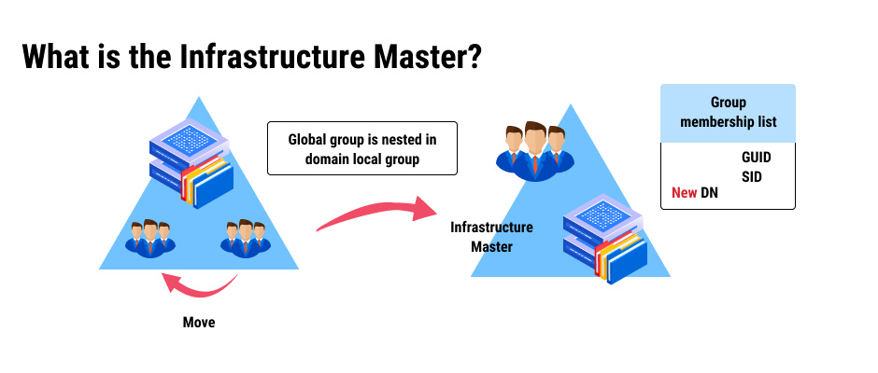
Infrastructure Master
Infrastructure Master is a domain wide role.
Infrastructure Master is used to update group members.
It is required for multi domain environments , it updates objects SID and DN in cross domain objects.

Slide 13
Why is Infrastructure Important?
The Schema Master is essential It enables organizations to customize their directory to meet their specific needs, ensure compatibility with existing applications, maintain data integrity and security, and adapt to changing requirements over time.

Slide 14
References
References
FSMO roles in Active Directory (2020) YouTube. Available at: https://www.youtube.com/watch?v=n5suPvKqo_Y (Accessed: 19 February 2024).
Deland-Han (no date) Active directory flexible single master operation (FSMO) roles in windows - windows server, Active Directory Flexible Single Master Operation (FSMO) roles in Windows - Windows Server | Microsoft Learn. Available at: https://learn.microsoft.com/en-us/troubleshoot/windows-server/active-directory/fsmo-roles (Accessed: 19 February 2024).

Slide 15
Any Questions ?

